Slide 1
CYBER SECURITY FRAUD DETECTION
SUBMITED BY- Aathi Muthu A

Slide 2
Overview
CYBER SECURITY
This project aims to develop a machine learning-based system for detecting fraud in cyber security transactions. The system utilizes various supervised and unsupervised learning techniques to analyze transactional data and identify potentially fraudulent activities. By employing advanced algorithms, the system can adapt to evolving fraud patterns and provide accurate predictions in real-time.

Slide 3
Data Collection
Model Selection
01
04
Data Preprocessing
Model Training
02
05
Exploratory Data Analysis (EDA)
Model Evaluation
03
06
We have collected this data form Kaggle with 11 datasets
In our ‘Attack’ variable we are having defaulter and there is only 0 and 1 value so we apply some of the classification models.
Cleanse and preprocess the collected data to prepare it for analysis .we have merged all the datasets into one dataset
Train the selected models using the preprocessed data. Split the data into training and testing sets to evaluate model performance effectively.
Perform EDA to gain insights into the distributions, identify correlations, and uncover potential patterns or anomalies that may aid in fraud detection on our sample dataset. Include feature Engineering
After applying all the models, we will compare all the accuracy of our models and find out best model from here.

Slide 4
MISSION STATEMENT
Apply EDA on this dataset and find some useful insight.
Our mission is to find out the best accuracy machine learning model for cyber security fraud detection

Slide 5
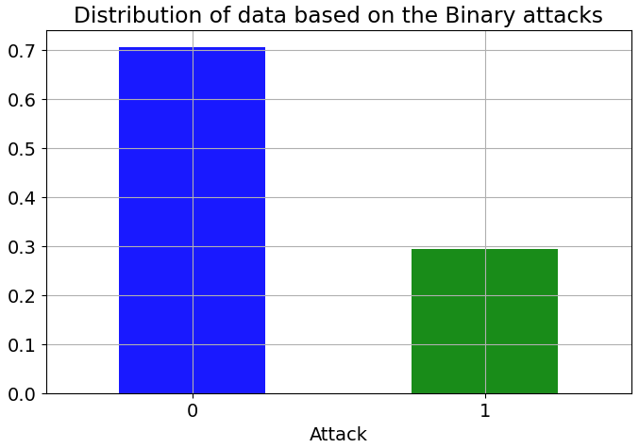
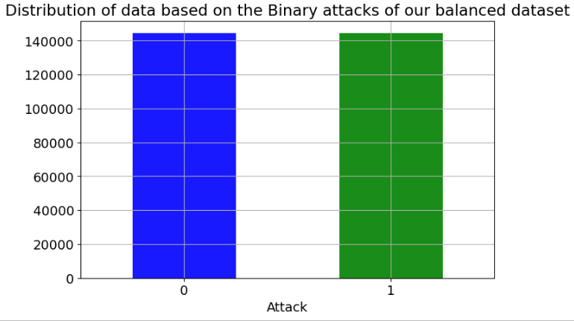
02
DATA PREPROCESSING
BEFORE UNDER SAMPLING
AFTER UNDER SAMPLING
Our dataset was highly unbalance 70% is normal 30% of attackers so we used under sampling technique to make the dataset balanced.

Slide 6


Data Preprocessing
#So, we can do Undersampling technique to balance the datasets
[sample.Attack == 0]
df_minority = sample[sample.Attack == 1]
df_majority_undersample = df_majority.sample(replace = False, n = 144503, random_state = 123)#random_state it's won't shuffle if we run this multiple time
b_sample = pd.concat([df_majority_undersample, df_minority])
print(b_sample.Attack.value_counts())
b_sample.shape
Unbalanced dataset value count
balanced dataset value count

Slide 7
03
Exploratory Data Analysis (EDA)
Perform EDA to gain insights into the characteristics of the data, understand the distributions, identify correlations, and uncover potential patterns or anomalies that may aid in fraud detection.

Slide 8
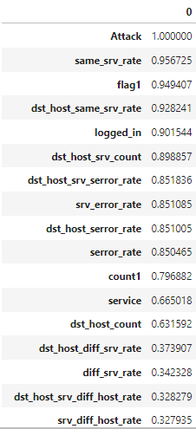
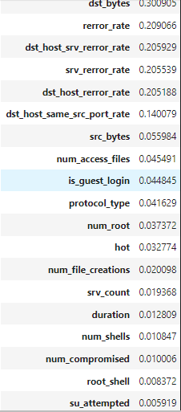
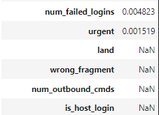
EDA
We have found the correlation with absolute values and the ‘same_srv_rate’ variable having top correlation with the ‘y’ variables ‘Attack’.
correlation=b_sample.corrwith(b_sample.Attack).abs().sort_values(ascending=False)
co_d=pd.DataFrame(correlation)

Slide 9
Exploratory Data Analysis (EDA)
We have moved out with the 30% of cut of and we have deleted all the variable where ever the relation is less than 30%
#deleting the varibales where having the relation with t he y variable is more than 30%
correlation[np.abs(correlation)>0.3].index.difference(['Attack'])
final_corr_data=corr_data.loc[ : : ,['count1', 'diff_srv_rate', 'dst_bytes', 'dst_host_count',
'dst_host_diff_srv_rate', 'dst_host_same_srv_rate',
'dst_host_serror_rate', 'dst_host_srv_count',
'dst_host_srv_diff_host_rate', 'dst_host_srv_serror_rate', 'flag1',
'logged_in', 'same_srv_rate', 'serror_rate', 'service',
'srv_diff_host_rate', 'srv_error_rate','Attack’]]
Using this code we have deleted all the variables where ever the relation with attack is less than 30%

Slide 10
Model Selection
In our dataset the “Y” variable is having ‘0’ and ‘1’ values and for this situation classification models are best.
Classification models
decision Tree classifier
Random Forest classifier
Logistic regression
KNN model
Naive bayes model
Ensemble Learning bagging Model

Slide 11
Model Evaluation
Evaluate the trained classification models using appropriate evaluation metrics such as accuracy, precision, recall and area under the ROC curve (AUC). Assessing the models' performance on both the training and testing datasets helps ensure they generalize well to unseen data.

Slide 12
Model Evaluation
All the classification models and their accuracy
Models | Accuracy
Decision Tree | 99.16%
Random Forest Classifier | 99.38%
Logistic Regression | 99.14%
KNN Models | 99.78%
Naïve Bayes | 99.02%
Ensemble Learning bagging | 99.98%

Slide 13
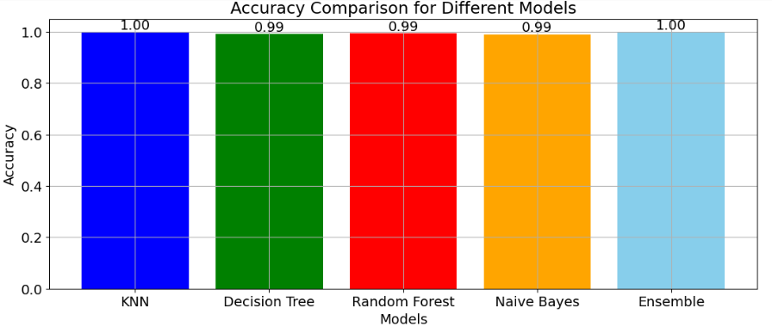
Model Evaluation
Right here we have compare all model’s accuracy with the bar plot. As we know logistic regression is having same accuracy as other models but we will chose logistic regression because this models is less prone to overfitting.
#Create a bar graph for knn, decision tree, random forest, and logistic regression
models = ['KNN', 'Decision Tree', 'Random Forest', 'Naive Bayes','Ensemble']
accuracy_values = [knn_aucc, dt_aucc, rf_aucc, naive_aucc,ensm_aucc]
plt.figure(figsize=(13, 5))
# Plot the bar graph
bars = plt.bar(models, accuracy_values, color=['blue', 'green', 'red', 'orange', 'skyblue'])
#Add accuracy values on top of each bar
plt.bar_label(bars, labels=[f"{acc:.2f}" for acc in accuracy_values])
#Add Labels and title
plt.xlabel('Models')
plt.ylabel('Accuracy')
plt.title('Accuracy Comparison for Different Models')
#Show the plot
plt.show()

Slide 14
Conclusion
In our dataset we are having 41 variables then we find out our 'Y' variable who is having good relation with most of the variables. Then we have decided that whichever variables having more than 30% correlation with the 'Y' variable 'Attack' that will be our final data set for machine learning. After that the final dataset is having now 18 variables including 'Y' variable.
Fraud Detection System represents a critical tool in the fight against cybercrime, providing organizations with the means to protect their assets and customers from fraudulent activities. we have applied so many machine learning models to get the perfect result without overfitting, and finally we get the final model using Logistic regression model there we got 99% accuracy and there is no overfitting.

Slide 15
Thank you!
This whole project and the presentation created by – Aathi Muthu A

